Slide 1

NHL Graph Analysis
Joshua Fisher
DSBA 6520 - Network Science

Slide 2
NHL Analytics
1990s – NHL started tracking game-by-game team and player statistics
2009 – Chicago Blackhawks were first team to collaborate with analytics company
2014 – Analytical specialist, Kyle Dubas, named assistant general manager (GM) of the Toronto Maple Leafs. Promoted to GM in 2018
Notes:
Created database to store every goal, shot, hit, etc

Slide 3
NHL Business
TV Contracts
Ticket Sales
Other
NHL earns ~$5 billion a year
Each team on average is valued at ~$650 million
$$$

Slide 4

Business Objective
The Seattle Kraken are set to become the 32nd NHL team this upcoming season
Expansion draft allows Seattle to select 1 unprotected player from each team
Research Question: “Which players are most central to hockey games?”
Notes:
Vegas excluded from the draft. 30 teams * 20 players = 600 players
To not overcomplicate things, I will be ignoring contracts and player protection.

Slide 5
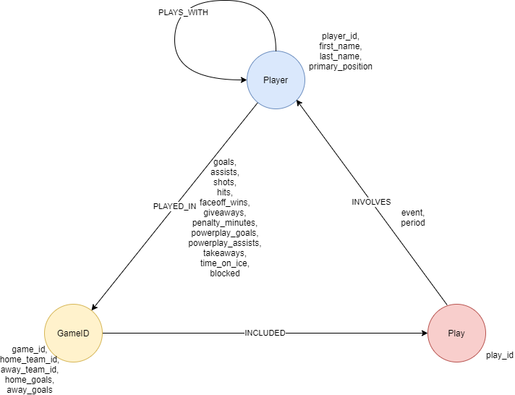
Data Model
Notes:
Memory limitation – first 300 games

Slide 6
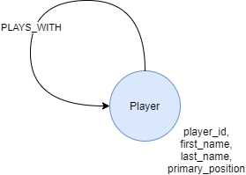

Projections

Slide 7
Data Exploration Cypher Query 1
name | degree
Leon Draisaitl | 42
Connor McDavid | 37
Brad Marchand | 32
John Carlson | 31
David Pastrnak | 31
Match (p:Player)-[n:INVOLVES]-()
WHERE n.event IN [‘Goal’, ‘Assist’]
RETURN p.first_name + ‘ ‘ + p.last_name as name, count(n.event) as degree
ORDER BY degree DESC

Slide 8
Data Exploration Cypher Query 2
name | plays_with_degree
Ryan Getzlaf | 159
Claude Giroux | 153
Jordan Staal | 136
Derek Grant | 129
Adam Henrique | 128
MATCH (p:Player)
WITH p, SIZE((p)<-[:PLAYS_WITH]-()) as plays_with_degree
RETURN p.first_name + ‘ ‘ + p.last_name as name, plays_with_degree
ORDER BY plays_with_degree DESC

Slide 9
Data Exploration Cypher Query 3
first_player | second_player | faceoffs_together_count
Brock Nelson | Aleksander Barkov | 29
Auston Matthews | Patrice Bergeron | 27
Anthony Cirelli | Aleksander Barkov | 25
Mark Schiefele | Sidney Crosby | 25
Jack Eichel | Anthony Cirelli | 22
MATCH (p:Player)-[i1:INVOLVES]-(pl:Play)-[i2:INVOLVES]-(p2:Player)
WHERE i1.event IN [‘Faceoff’] AND i2.event IN [‘Faceoff’] AND id(p1)<id(p2)
RETURN p1.first_name + ‘ ‘ + p1.last_name as first_player,
p2.first_name + ‘ ‘ + p2.last_name as second_player,
COUNT(pl) as faceoffs_together_count
ORDER BY faceoffs_together _count DESC

Slide 10
Graph Algorithms
Centrality
PageRank
Betweenness
Community Detection
Modularity Optimization
Degree
Name | Score
Ryan Getzlaf | 1.984
Radek Faksa | 1.975
Jordan Staal | 1.921
Name | Score
William Karlsson | 30.867
Filip Chlapik | 27.333
Radek Faksa | 27.083
Name | Score
Ryan Getzlaf | 163
Lars Eller | 157
Jordan Staal | 155
Name | CommunityID
Shayne Gostisbehere | 721
Claude Giroux | 721
Travis Konecny | 721
Notes:
PageRank – estimate node’s importance by looking at what other nodes it shares a relationship with and their importance
Betweenness – who are the main components to the network. Which player has influence over other players
Degree – estimates player’s importance by looking at how many edges it has
Modularity optimization – finds clusters of similar players

Slide 11
Graph Machine Learning
Player | Embedding
Claude Giroux | [0.11221969980490319,0.1318266041815291,0.1232...
Travis Konecny | [0.11223483076995378,0.13173648205579874,0.123...
Ivan Provorov | [0.11223948957578837,0.1317080497596955,0.1230...
GraphSAGE
Merge
Player | Goals
Claude Giroux | 5
Travis Konecny | 8
Ivan Provorov | 4
 | 1 | 2 | 3
1 | 83 | 86 | 37
2 | 9 | 8 | 11
3 | 2 | 4 | 2
Target Variable
Independent Variables
Player | Goals | Embedding_0 | Embedding_1 | Embedding_n
Claude Giroux | 1 | 0.112220 | 0.131827 | ###
Travis Konecny | 2 | 0.112235 | 0.131736 | ###
Ivan Provorov | 1 | 0.112239 | 0.131807 | ###
Expand embeddings and categorize goals
SVC
Notes:
GraphSAGE = inductive learning = learner discovers rules by observing examples

Slide 12
Cypher Actions
Search Phrase 1 – “Which players have been involved in the most goals and assists plays with Player $last_name”
Search Phrase 2 – “Which players are in the community $community”

Slide 13
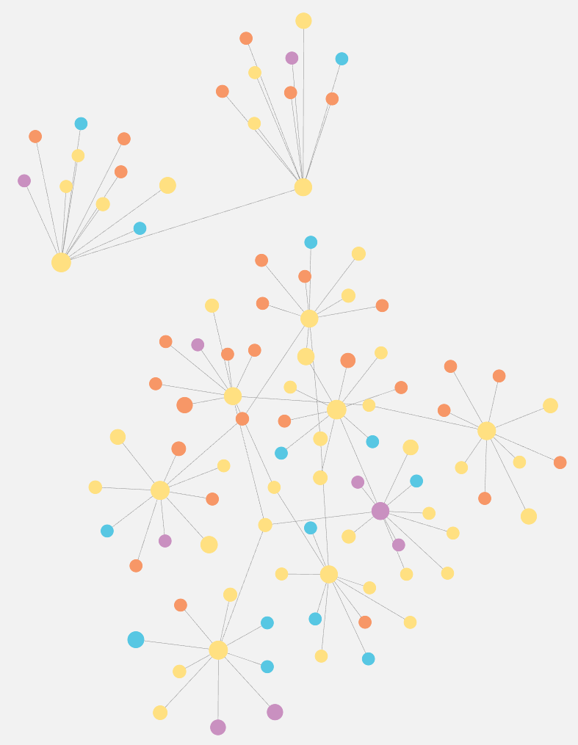
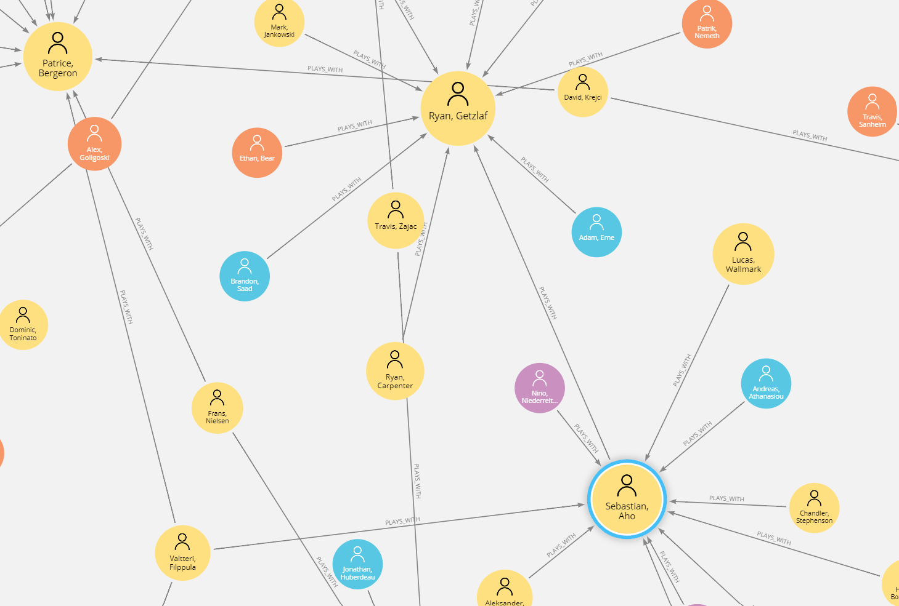
Visualization 1
Top 10 players by PageRank and their connection to other players, ranked by connection degree

Slide 14
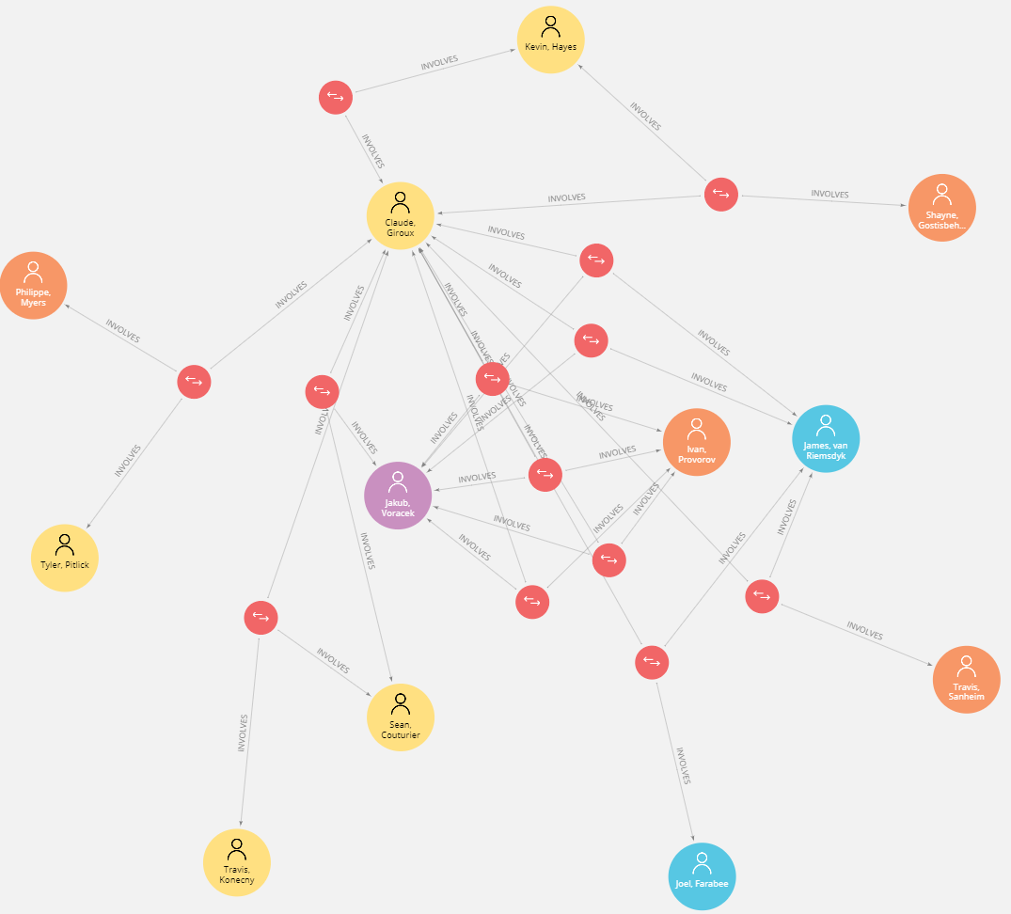
Visualization 2
Example use of Cypher Action 1: “Which players have been involved in the most goals and assist plays with Player Giroux”

Slide 15
Demo

Slide 16
Players to Target
Brad Marchand
Ryan Getzlaf
Travis Konecny
LW
C
RW
Shayne Gostisbehere
John Carlson
D
D

Slide 17
Questions?

